Slide 1

MAJOR PROJECT-II PRESENTATION ON Swish – real time chat
SCHOOL OF ENGINEERING AND TECHNOLOGY
DEPARTMENT OF COMPUTER SCIENCE AND ENGINEERING
Presented By:
Biswajeet Panda (21UG010252)
Jagannath Patro (21UG010351)
Rishav Kumar (21UG010530)
Under the Guidance of
Prof. VSK Chaitanya
Class teacher: Chandra Mohan Rakoti, Asst. Professor
Dept. Of CSE,
GIET University , Gunupur

Slide 2
OUTLINES
S.NO. | CONTENTS | PAGE NO.
1 | PROBLEM STATEMENT | 3
2 | INTRODUCTION | 4
3 | TECHNOLOGIES USED | 5
4 | NECESSARY DIAGRAMS | 6
5 | FEATURES | 7
6 | CHALLENGES | 8
7 | LIMITATIONS | 9
8 | SCREENSHOTS | 10
9 | CONCLUSION | 11
10 | FUTURE ENHANCEMENT | 12
11 | REFERENCES | 13

Slide 3
PROBLEM STATEMENT
In today’s fast-paced digital era, seamless and instant communication is essential for both personal and professional interactions. However, many existing chat applications are either overloaded with features that compromise performance or lack real-time responsiveness, security, or scalability. There is a need for a lightweight, responsive, and efficient real-time messaging application that allows users to communicate instantly in a secure environment.
"Swish - Real-Time Chat" aims to address this gap by developing a web-based real-time chat application using the MERN (MongoDB, Express.js, React.js, Node.js) stack that offers a smooth, responsive interface and enables users to send and receive messages instantly, with features like user authentication, real-time message delivery using WebSockets, and a clean, intuitive UI.

Slide 4
INTRODUCTION
Communication has become an integral part of modern life, with instant messaging applications playing a crucial role in connecting people across the globe. As the demand for real-time, responsive, and user-friendly chat platforms grows, there is a continuous need to build efficient systems that cater to these expectations.
Swish - Real-Time Chat is a web-based chat application developed using the MERN stack (MongoDB, Express.js, React.js, and Node.js). It is designed to provide seamless real-time communication between users with features such as user authentication, live message exchange using WebSockets (via Socket.io), and an intuitive user interface.
The project focuses on delivering a lightweight yet powerful chatting experience that emphasizes speed, responsiveness, and ease of use. Swish ensures that users can interact in real-time, with messages being delivered and displayed instantly without needing to refresh the page, making it a reliable and efficient communication tool for everyday use.

Slide 5
TECHNOLOGIES USED
Frontend
React.js
Tailwind CSS
daisyUI
Zustand
Axios
Backend
Node.js
Express.js
Socket.io
Postman
Database
MongoDB
Mongoose
Authentication and Security
JWT(JSON Web Token)
bcrypt.js

Slide 6
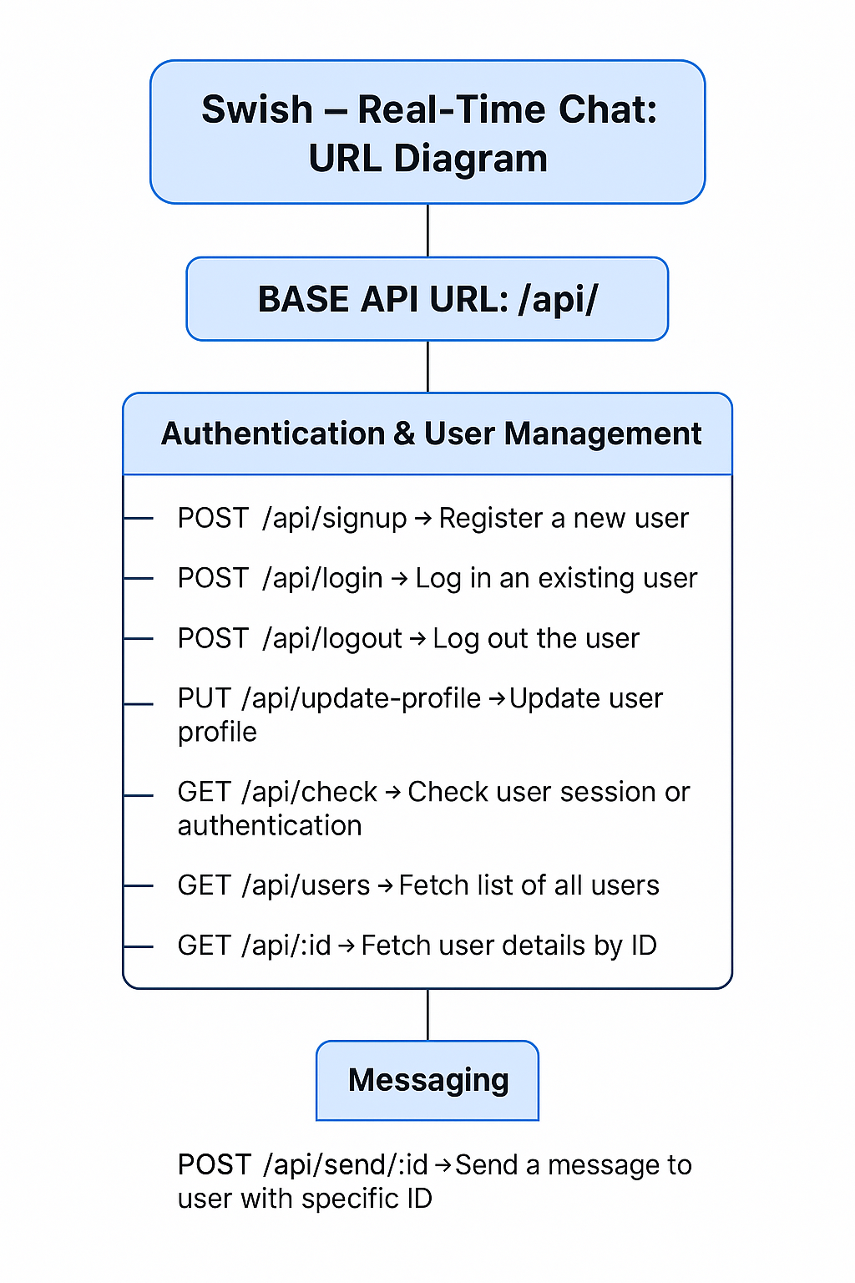
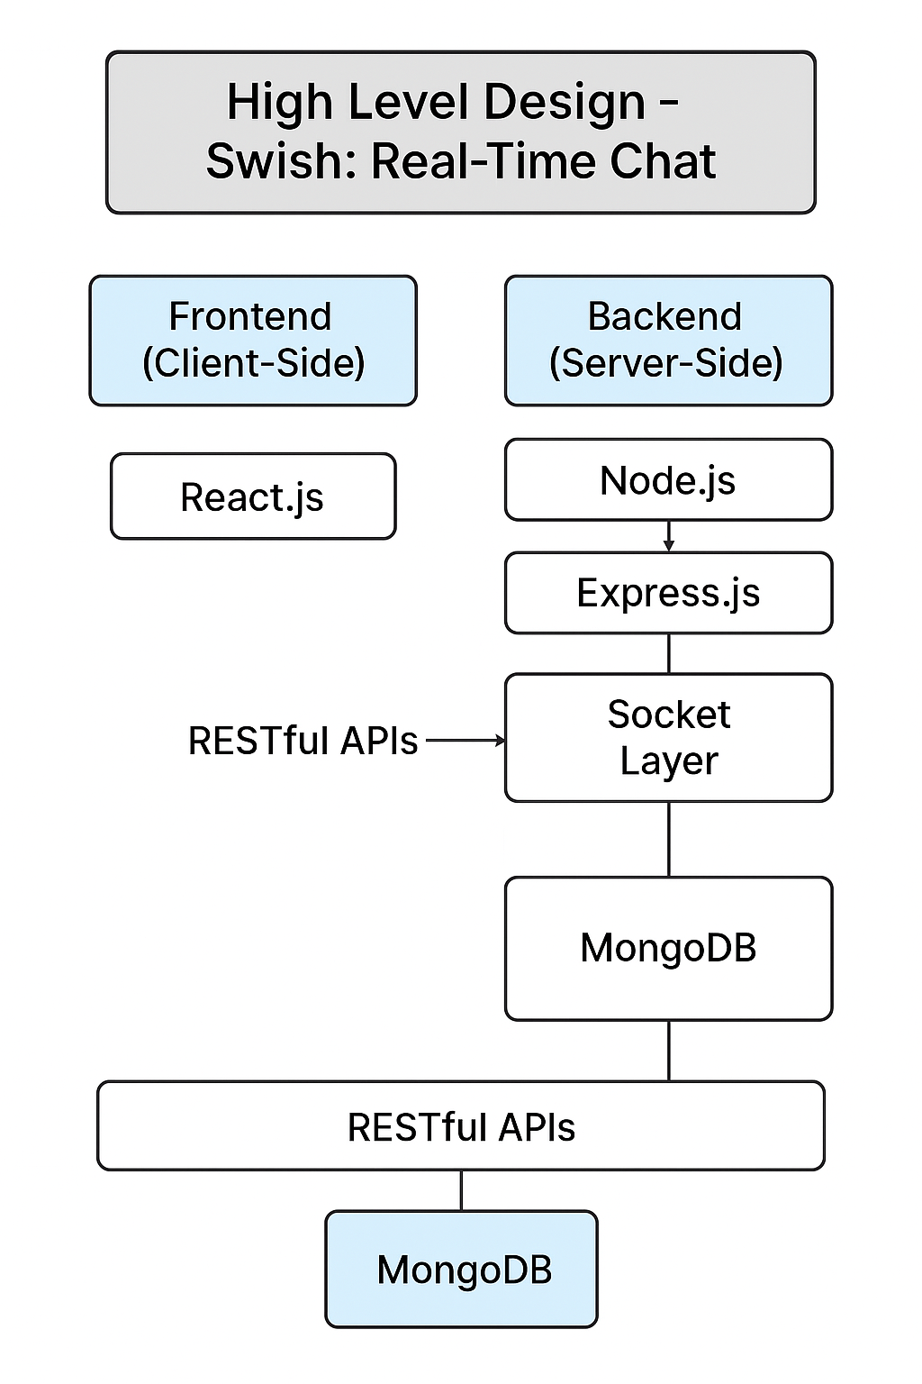
NECESSARY DIAGRAMS
HLD (High-Level Design)
URL Diagram

Slide 7
FEATURES
User registration and secure login with JWT authentication
Real-time one-on-one chat functionality using Socket.io
Responsive and intuitive UI built with React.js, Tailwind CSS, and daisyUI
Lightweight state management using Zustand for better performance
Display of online users and chat history
Instant message delivery without page refresh
Password encryption using bcrypt.js for added security
MongoDB integration for storing user data and chat messages
Organized and readable chat interface with timestamps
Clean code architecture for scalability and maintainability

Slide 8
CHALLENGES
Implementing real-time communication and ensuring consistent message delivery using Socket.io
Managing authentication securely with JWT while protecting sensitive user data
Structuring the backend efficiently to handle multiple concurrent socket connections
Handling state management across components using Zustand without performance lags
Designing a responsive and user-friendly UI that works well on different screen sizes
Syncing frontend and backend data flows, especially during live chat updates
Ensuring database consistency and managing relationships between users and messages in MongoDB
Integrating Tailwind CSS with daisyUI components for a clean and aesthetic design

Slide 9
LIMITATIONS
Messages are not end-to-end encrypted, posing security concerns
No offline support or Progressive Web App (PWA) features
User interface may not be fully responsive across all devices
No typing indicator or message read receipts implemented
Limited authentication features (e.g., no 2FA or password reset)
Group chat functionality may be basic or unavailable
Notifications may not work without background service integration

Slide 10
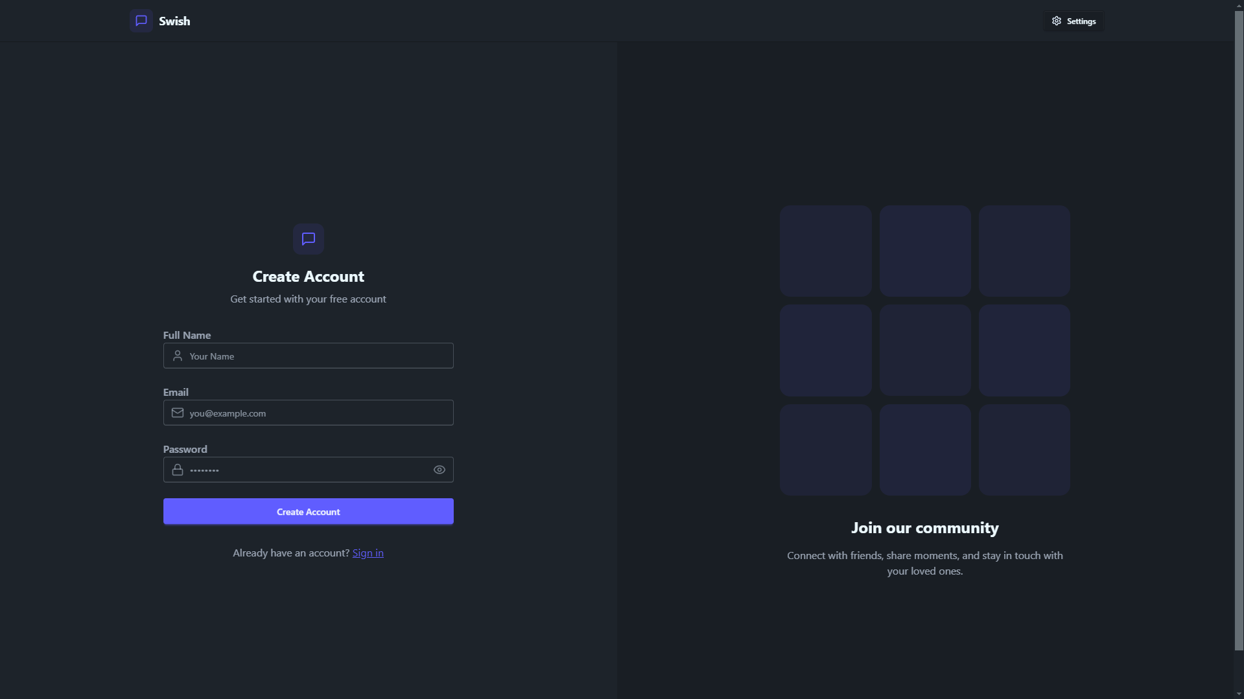
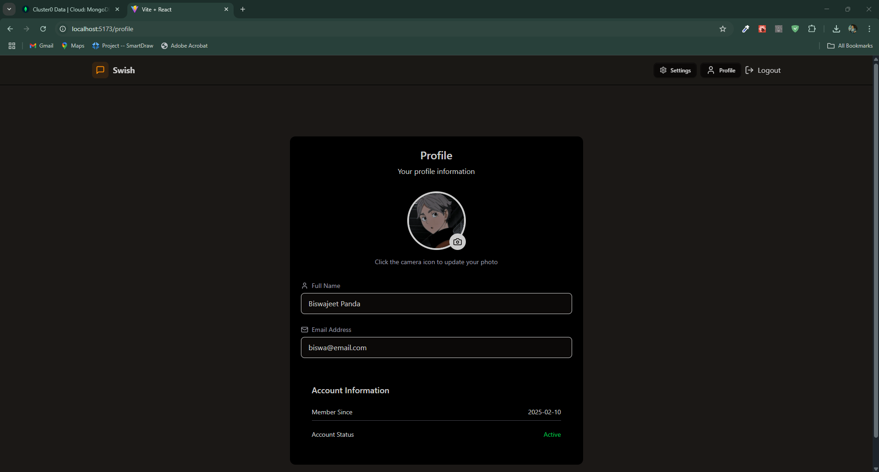
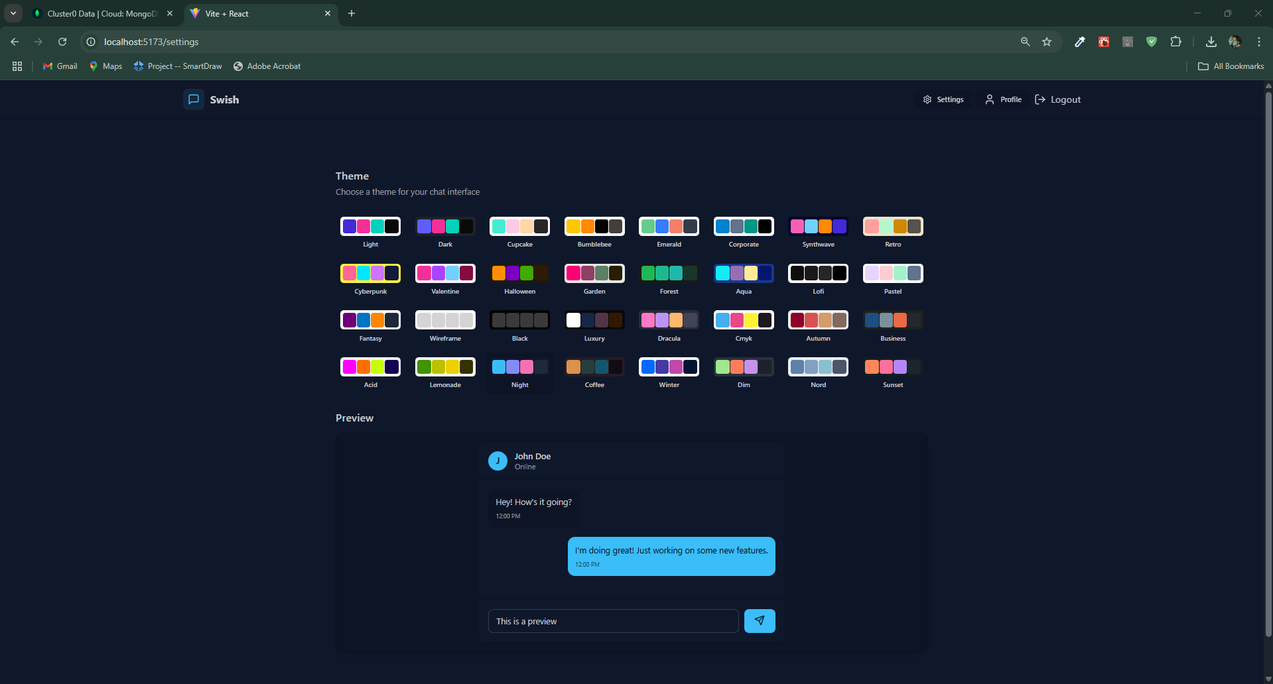
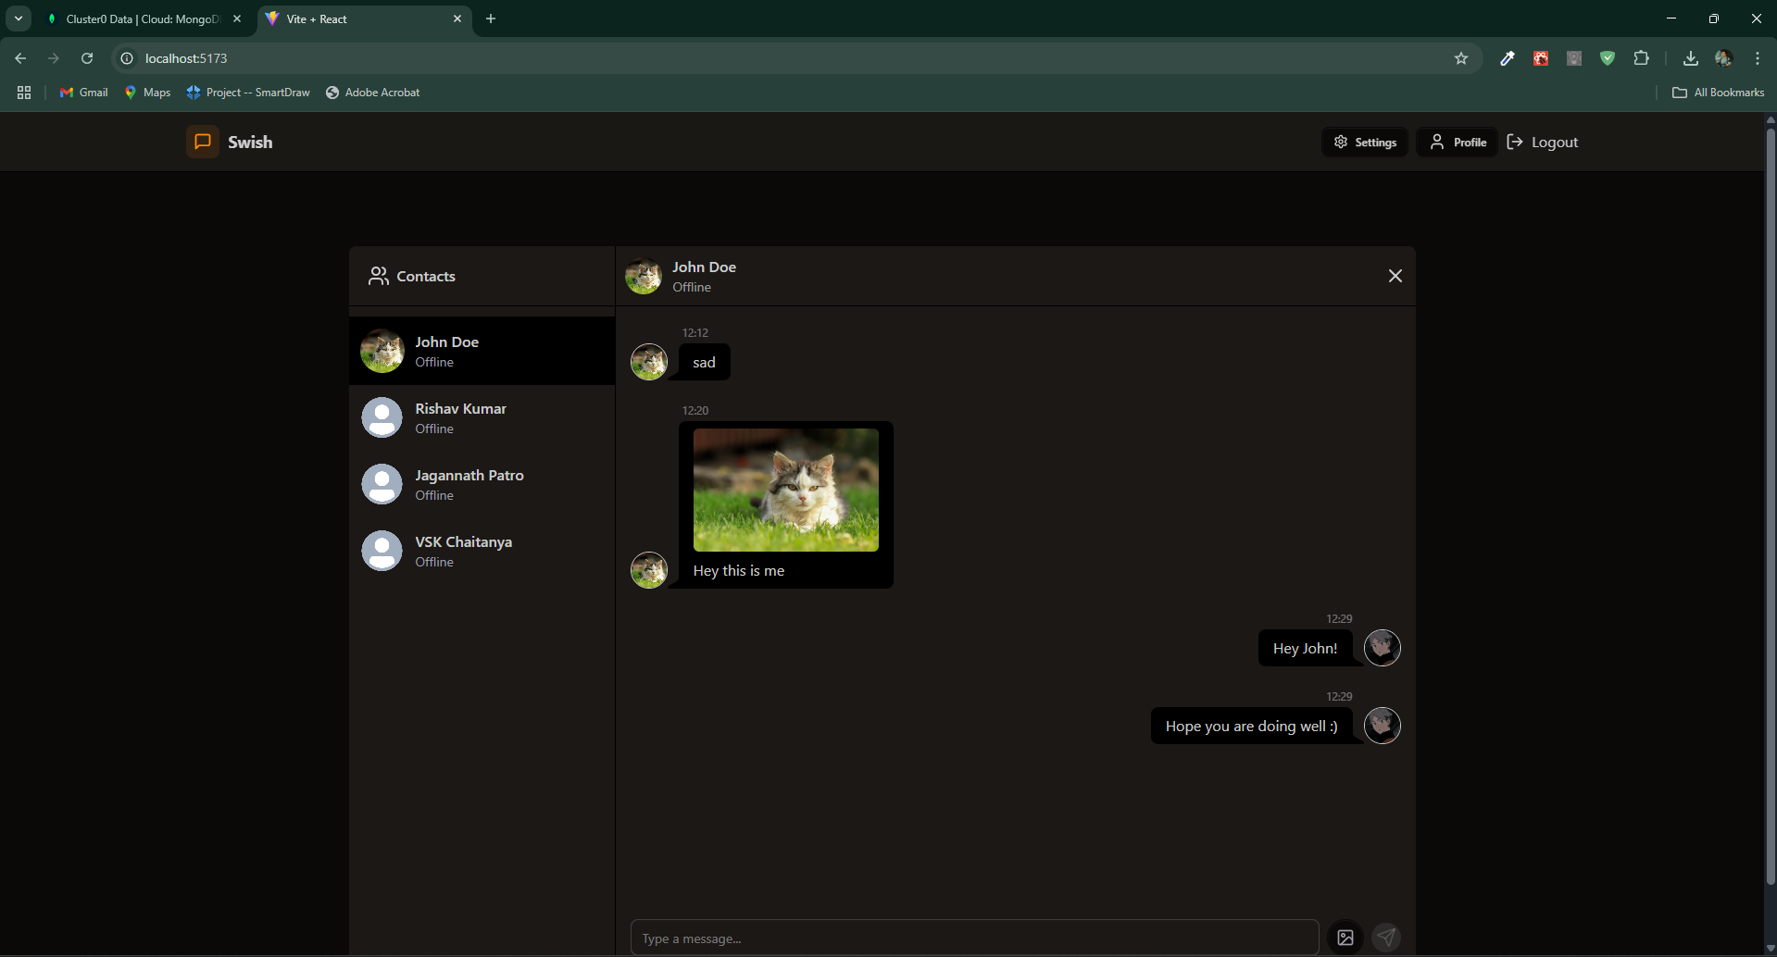
SCREENSHOTS

Slide 11
CONCLUSION
The Swish – Real-Time Chat application successfully demonstrates the core functionalities of a modern messaging platform using the MERN stack and Socket.io. It enables users to communicate instantly with a clean, interactive UI and real-time message synchronization. Through this project, key concepts like RESTful API development, real-time event handling, and secure user authentication were implemented effectively.
Although the current version focuses on core messaging features, it lays a solid foundation for future improvements such as voice/video calls, and advanced security measures like end-to-end encryption. With scalability and user experience in mind, Swish has the potential to evolve into a fully-featured real-time communication platform.

Slide 12
FUTURE ENHANCEMENT
Implement voice and video calling features using WebRTC.
Integrate message encryption (end-to-end) for security.
Add notification support for new messages in real-time.
Incorporate typing indicators and read receipts.
Add dark mode and customizable UI themes
Allow chat search by keyword, user, or date
Add two-factor authentication (2FA) and secure login flows

Slide 13
REFERENCES
https://www.youtube.com/watch?v=xtXVZnlkV1U (Build a Real-Time Chat App with React, Node.js, Socket.io)
https://www.youtube.com/watch?v=ZwFA3YMfkoc (Build a Real-Time Chat App with MERN Stack and Socket.io)
https://www.youtube.com/watch?v=tbrfRaXqUec (MERN Stack Chat App Tutorial | Full-Stack Chat Application)
https://www.youtube.com/watch?v=0kBu_H6ZciQ (WhatsApp Clone with React, Firebase & Material UI)
https://www.youtube.com/watch?v=ZKEqqIO7n-k (Build a Real-Time Chat App with Firebase and React.js)
https://www.youtube.com/watch?v=0X0QJ3Yj5hI (Real-Time Chat App using Node.js and Socket.io)

